Slide 1
General Purpose IO (GPIO) (Low level IO)
Md. Khalilur Rhaman PhD
Associate Professor
CSE Department
BRAC University

Slide 2
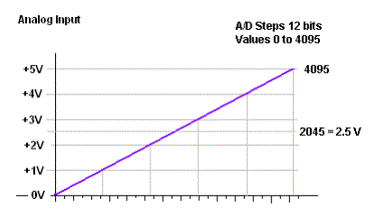
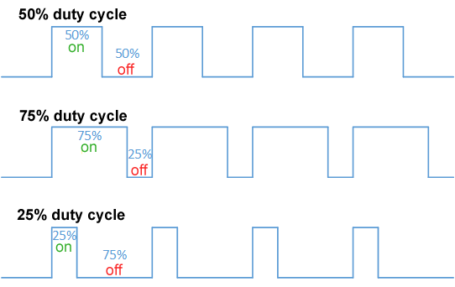
Input Output
IO
Input
Output
Digital (0/1)
Analog (0~5v)
Digital
Pulse Width Modulation (PWM)

Slide 4
Basic Concepts in I/O Interfacing
I/O devices (or peripherals) such as LEDs, LCDs, keyboards etc. are essential components of the microprocessor-based or microcontroller-based systems. Those can be classified into two groups
input devices
output devices

Slide 5
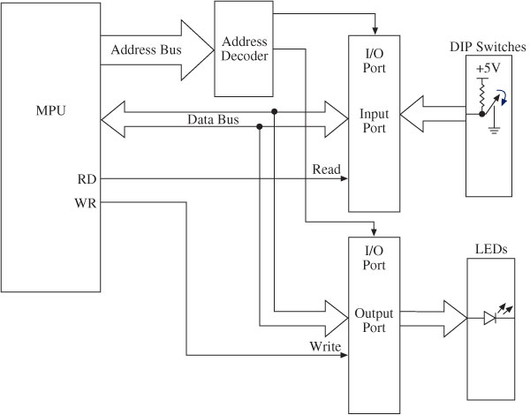
Block Diagram of I/O Interfacing
Buffer
Latch
Buffer keep the level of 0 or 1 (to resolve fan in problem)
Latch hold the value (0/1) until it is cleared

Slide 6
I/O Ports: Interfacing and Addressing
To read (receive) binary data from an input peripheral
MPU places the address of an input port on the address bus, enables the input port by asserting the RD signal, and reads data using the data bus.
To write (send) binary data to an output peripheral
MPU places the address of an output port on the address bus, places data on data bus, and asserts the WR signal to enable the output port.

Slide 7
Output
Light Emitting Diode (LED)
Seven segment display (Alphanumeric)
Matrix Display
Liquid Crystal Display (LCD)
Buzzer
DC Motor
Servo Motor
Stepper Motor

Slide 8
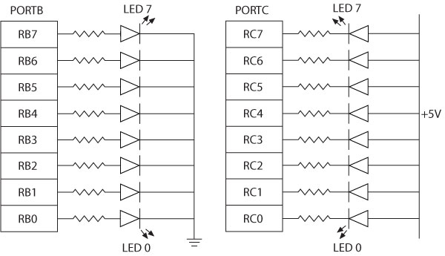
Interfacing LED
Two ways of connecting LEDs to I/O ports:
Common Cathode - The current is supplied by the I/O port called current sourcing.
Common Anode - The current is received by the chip called current sinking.
Common Cathode
Common Anode

Slide 9
Interfacing Seven-Segment
Seven-segment LEDs
Often used to display BCD numbers (0 through 9) and a few alphabets
A group of eight LEDs physically mounted in the shape of the number eight plus a decimal point
Each LED is called a segment and labeled as ‘a’ through ‘g’.

Slide 10
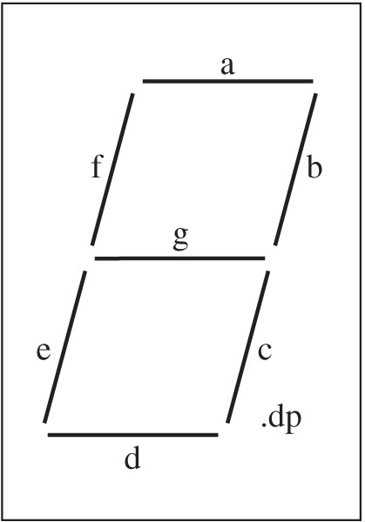
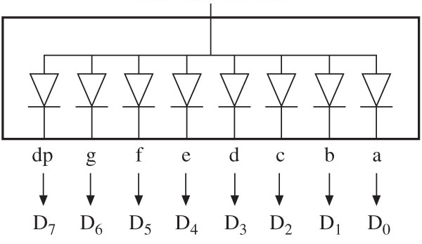
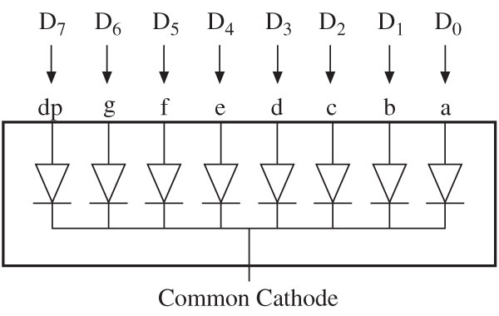
Interfacing Seven-Segment
Two types of seven-segment LEDs
Common anode
Common cathode
Common anode
decimal point

Slide 11
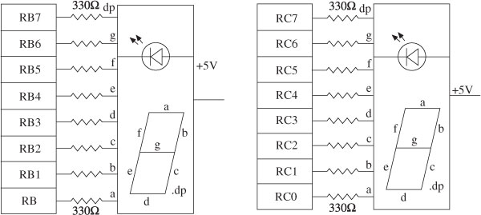
Interfacing Seven-Segment LEDS to PORTs

Slide 12
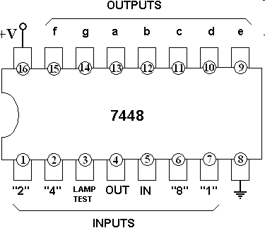
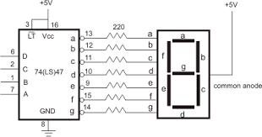
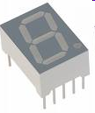
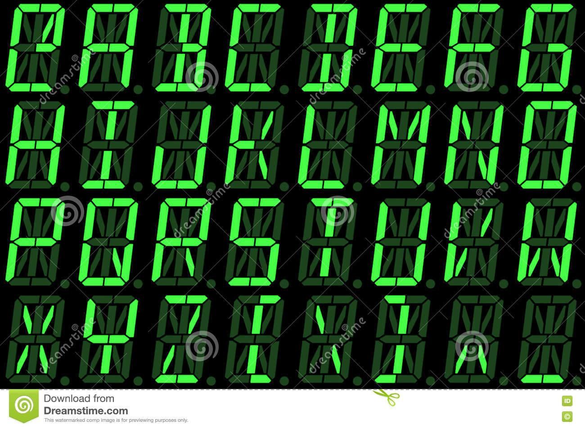
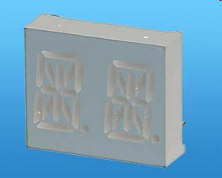
Seven-Segment Chips
ALPHA/NUMERIC DISPLAY

Slide 13
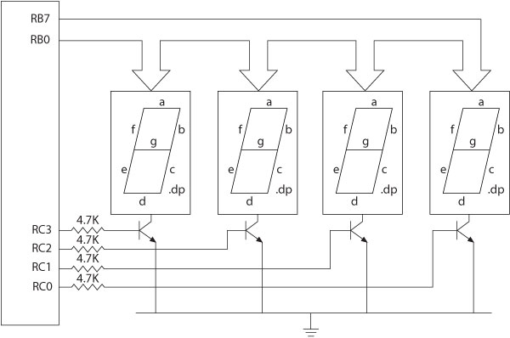

Interfacing to Multiple 7-Segments

Slide 14
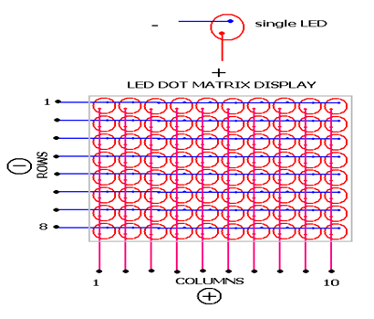
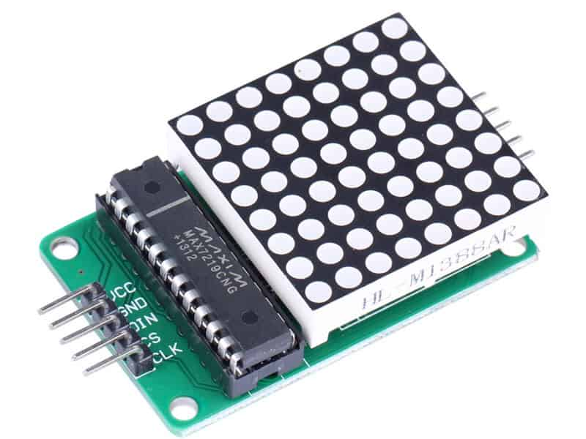
LED Matrix Display

Slide 15
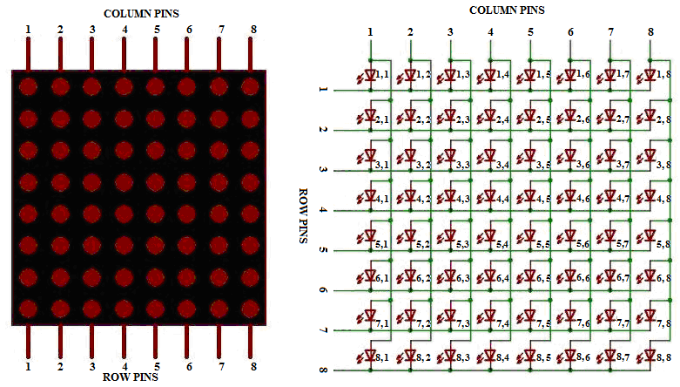
LED Matrix Display

Slide 16
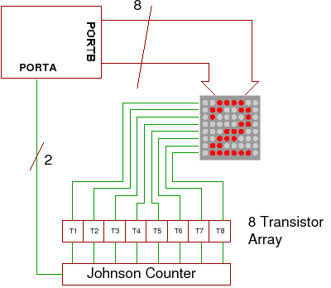
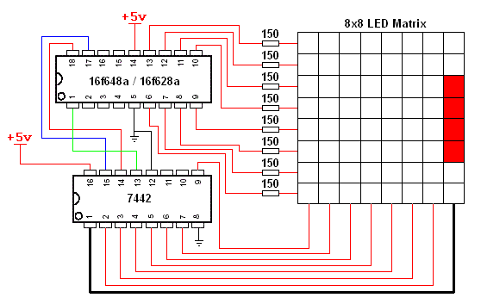
LED Matrix Display

Slide 17
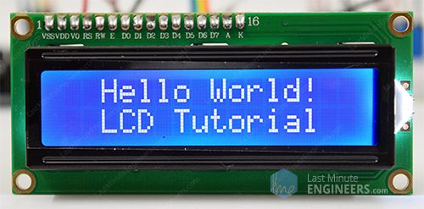
LCD
Interface a 2-line x 16 character LCD module with the built-in controller to I/O ports of the PIC18 microcontroller
LCD has a display Data RAM (registers) that stores data in 8-bit character code in ASCII.
Each register in Data RAM has its own address that corresponds to its position on the line.

Slide 18
LCD
Three control signals:
RS (Register Select)
RW (Read/Write)
E (Enable)
Three power connections
Power (Vcc),
Ground
Variable register to control the brightness
Driver has two 8-bit internal registers
Instruction Register (IR) to write instructions to set up LCD
Data Register (DR) to write data (ASCII characters)

Slide 19
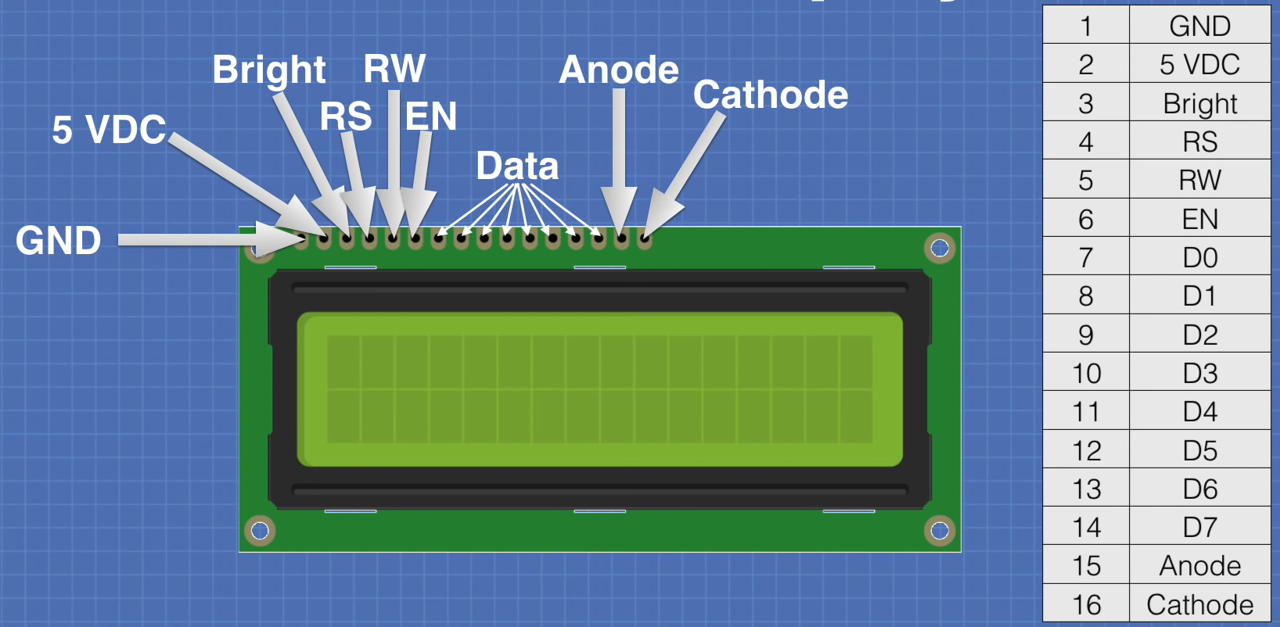
LCD can be interfaced either in 8-bit or 4-bit mode

Slide 20
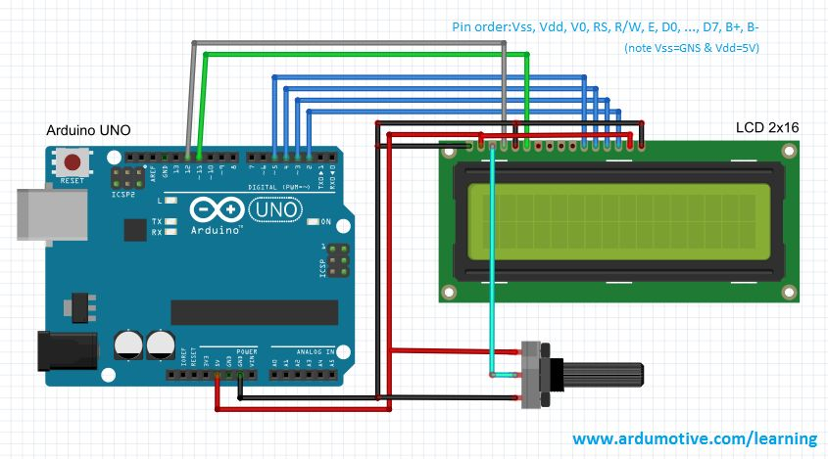
Connection with half byte mode

Slide 21
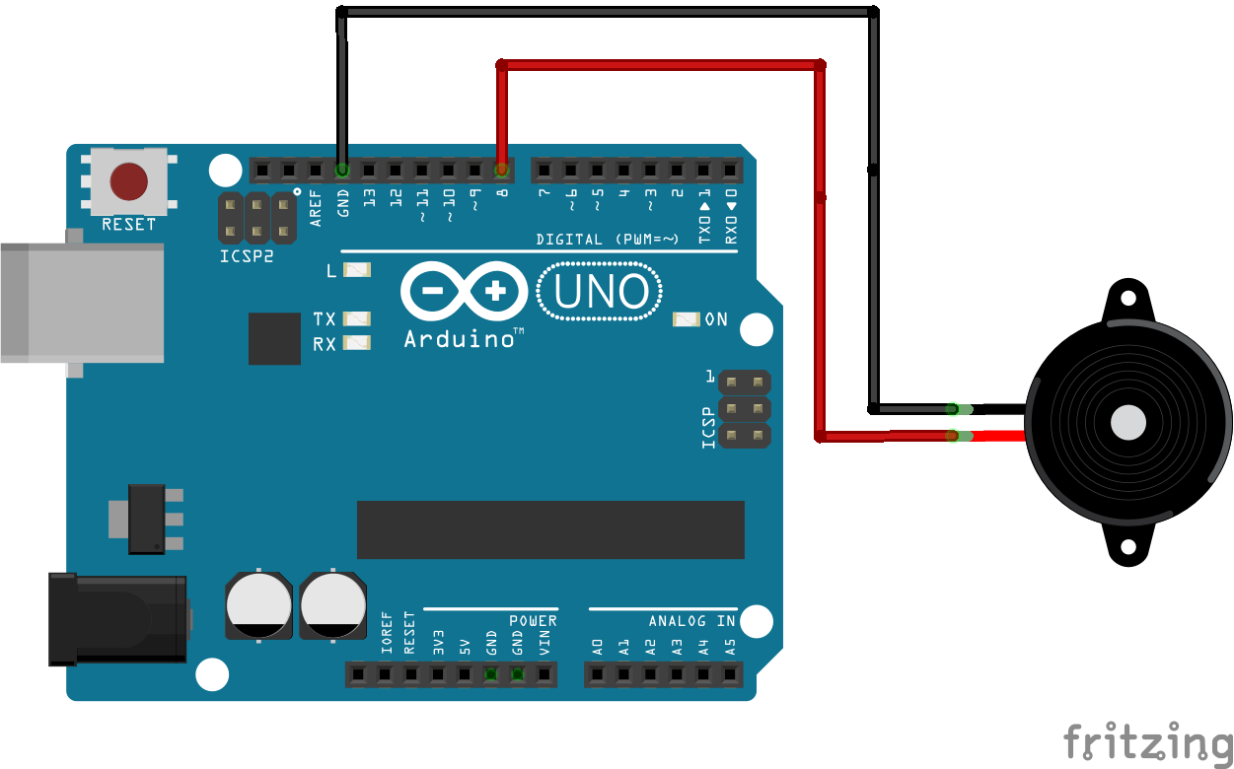
Buzzer

Slide 22
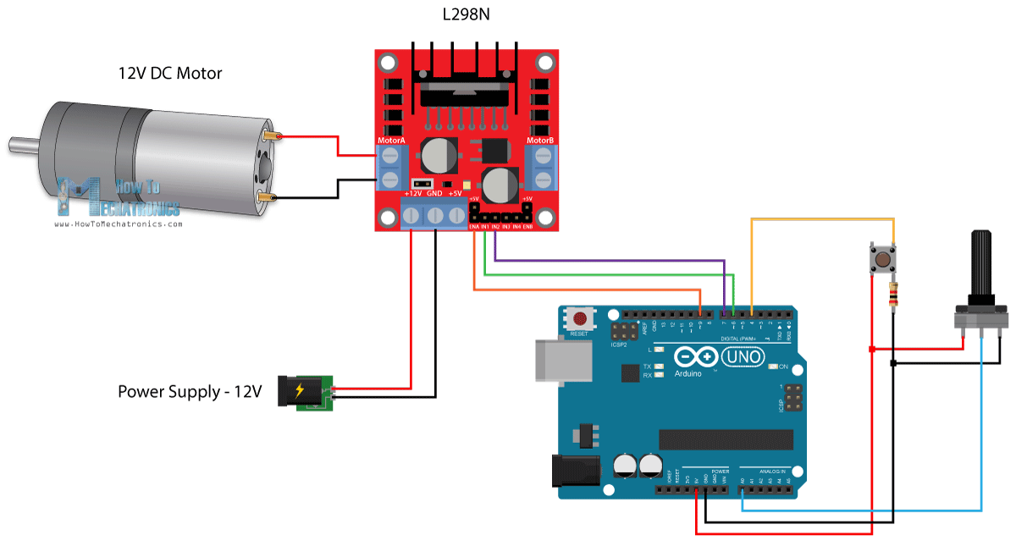
DC Motor

Slide 23
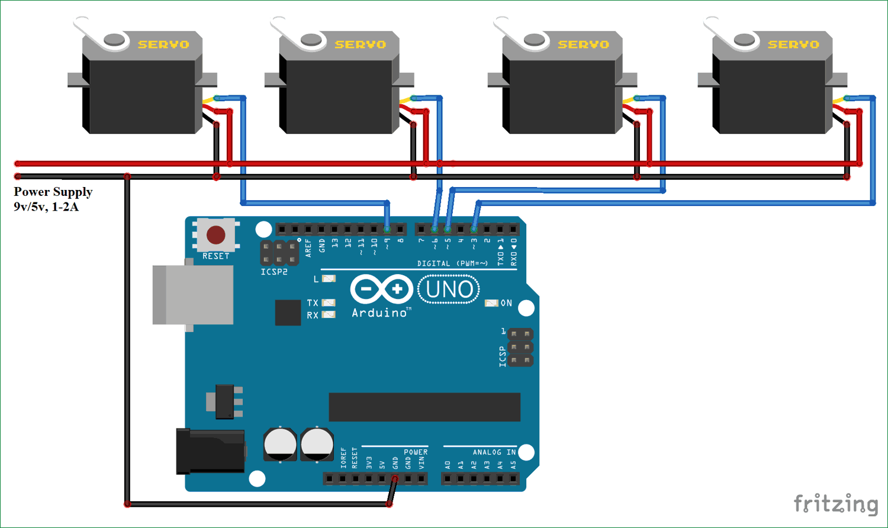
Servo Motor

Slide 24
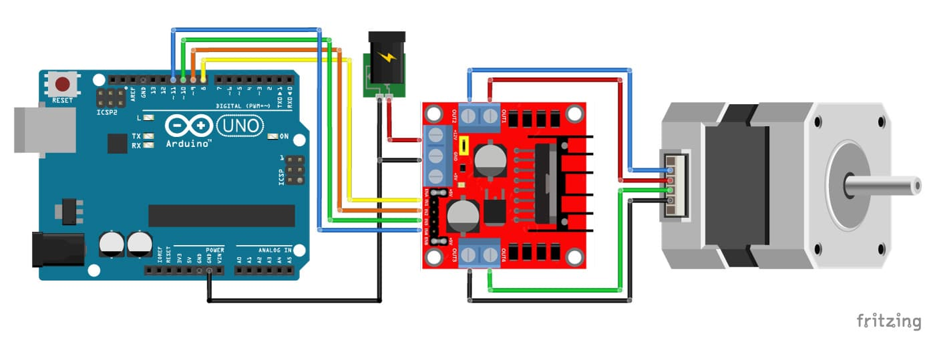
Stepper Motor

Slide 25
Input
Dip Switch
Push-Button Switch
Matrix Keyboard
Analog Input (Sensors)

Slide 26
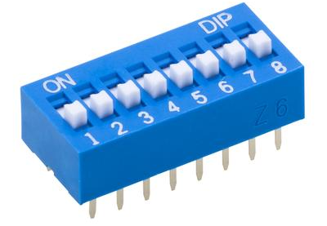
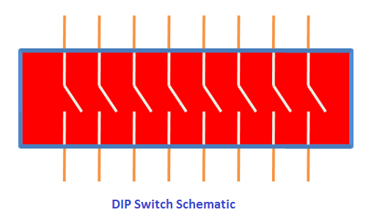
DIP switch
One side of the switch is tied high (to a power supply through a resistor called a pull-up resistor), and the other side is grounded. The logic level changes when the position is switched.

Slide 27
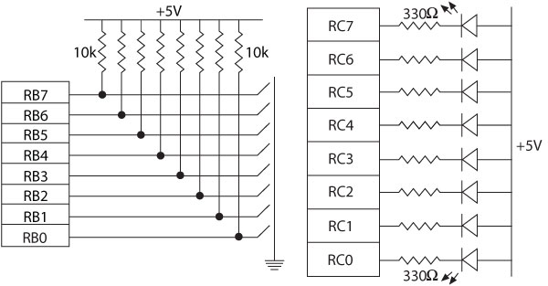
Interfacing Dip Switches and Interfacing LEDs

Slide 28
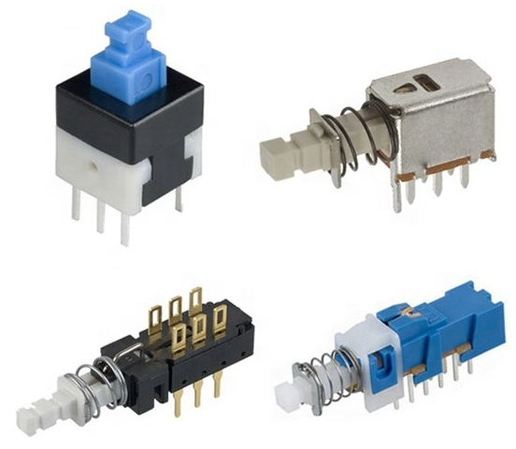
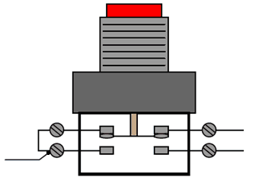
Push-button key
The connection is the same as in the DIP switch except that contact is momentary.
When a key is pressed (or released), mechanical metal contact bounces momentarily and can be read.

Slide 29
Key Debouncing
The reading of one contact as multiple inputs can be eliminated by a key-debounce technique, using either hardware or software.
Software Key Debouncing
Wait for 20 ms.
Read the port again.
If the reading is still less than FFH, it indicates that a key is pressed.

Slide 30
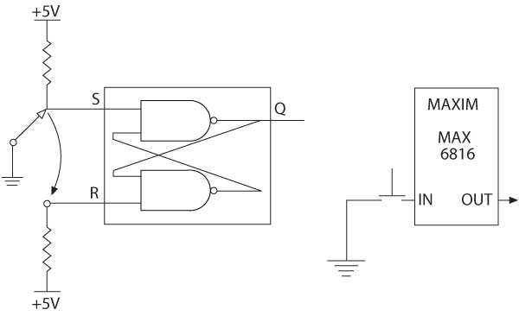
Hardware Key Debounce Techniques
Hardware technique is based on the principles of generating a delay and switching the logic level at a certain threshold level.
S-R latch: The output of the S-R latch is a pulse without a bounce.
Multiplexer that bounces the key internally and provides a steady output.

Slide 31
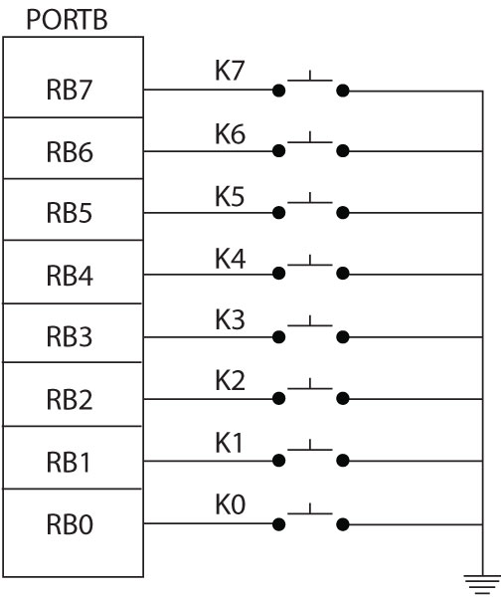
Illustration: Interfacing Push-Button Keys (1 of 6)
Problem statement
A bank of push-button keys are connected as inputs to PORTB.
The pull-up resistors are internal to PORTB.
Write a program to recognize a key pressed, debounce the key, and identify its location in the key bank with numbers from 0 to 7.

Slide 32
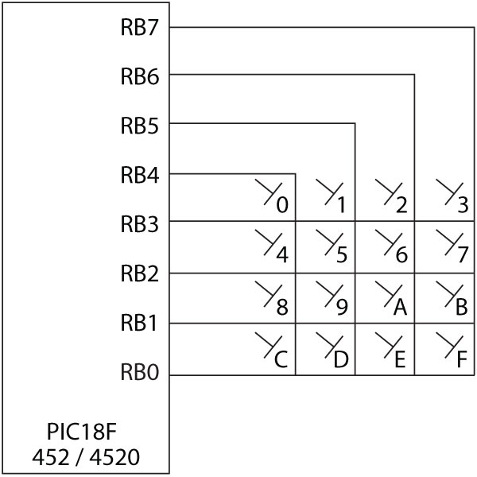
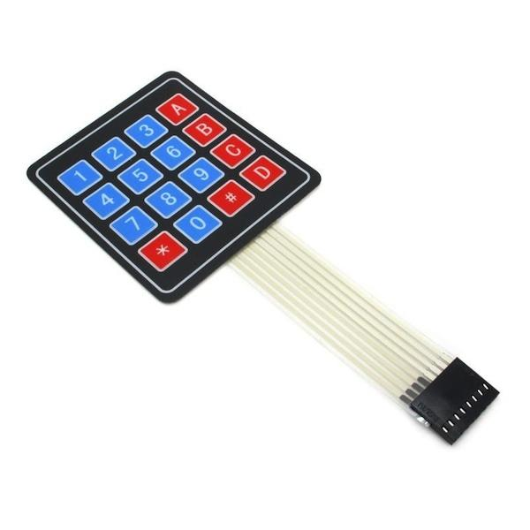
Interfacing a Matrix Keyboard

Slide 33
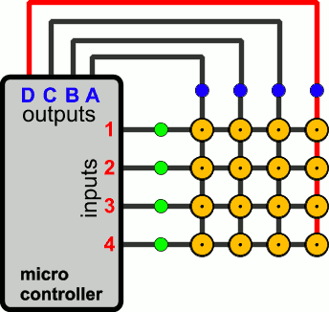
Interfacing a Matrix Keyboard
Ground one column at a time and check all the rows in that column.
Once a key is identified, it is encoded based on its position in the column.

Slide 34
Sensors will be discussed in next session…

